Slide 1
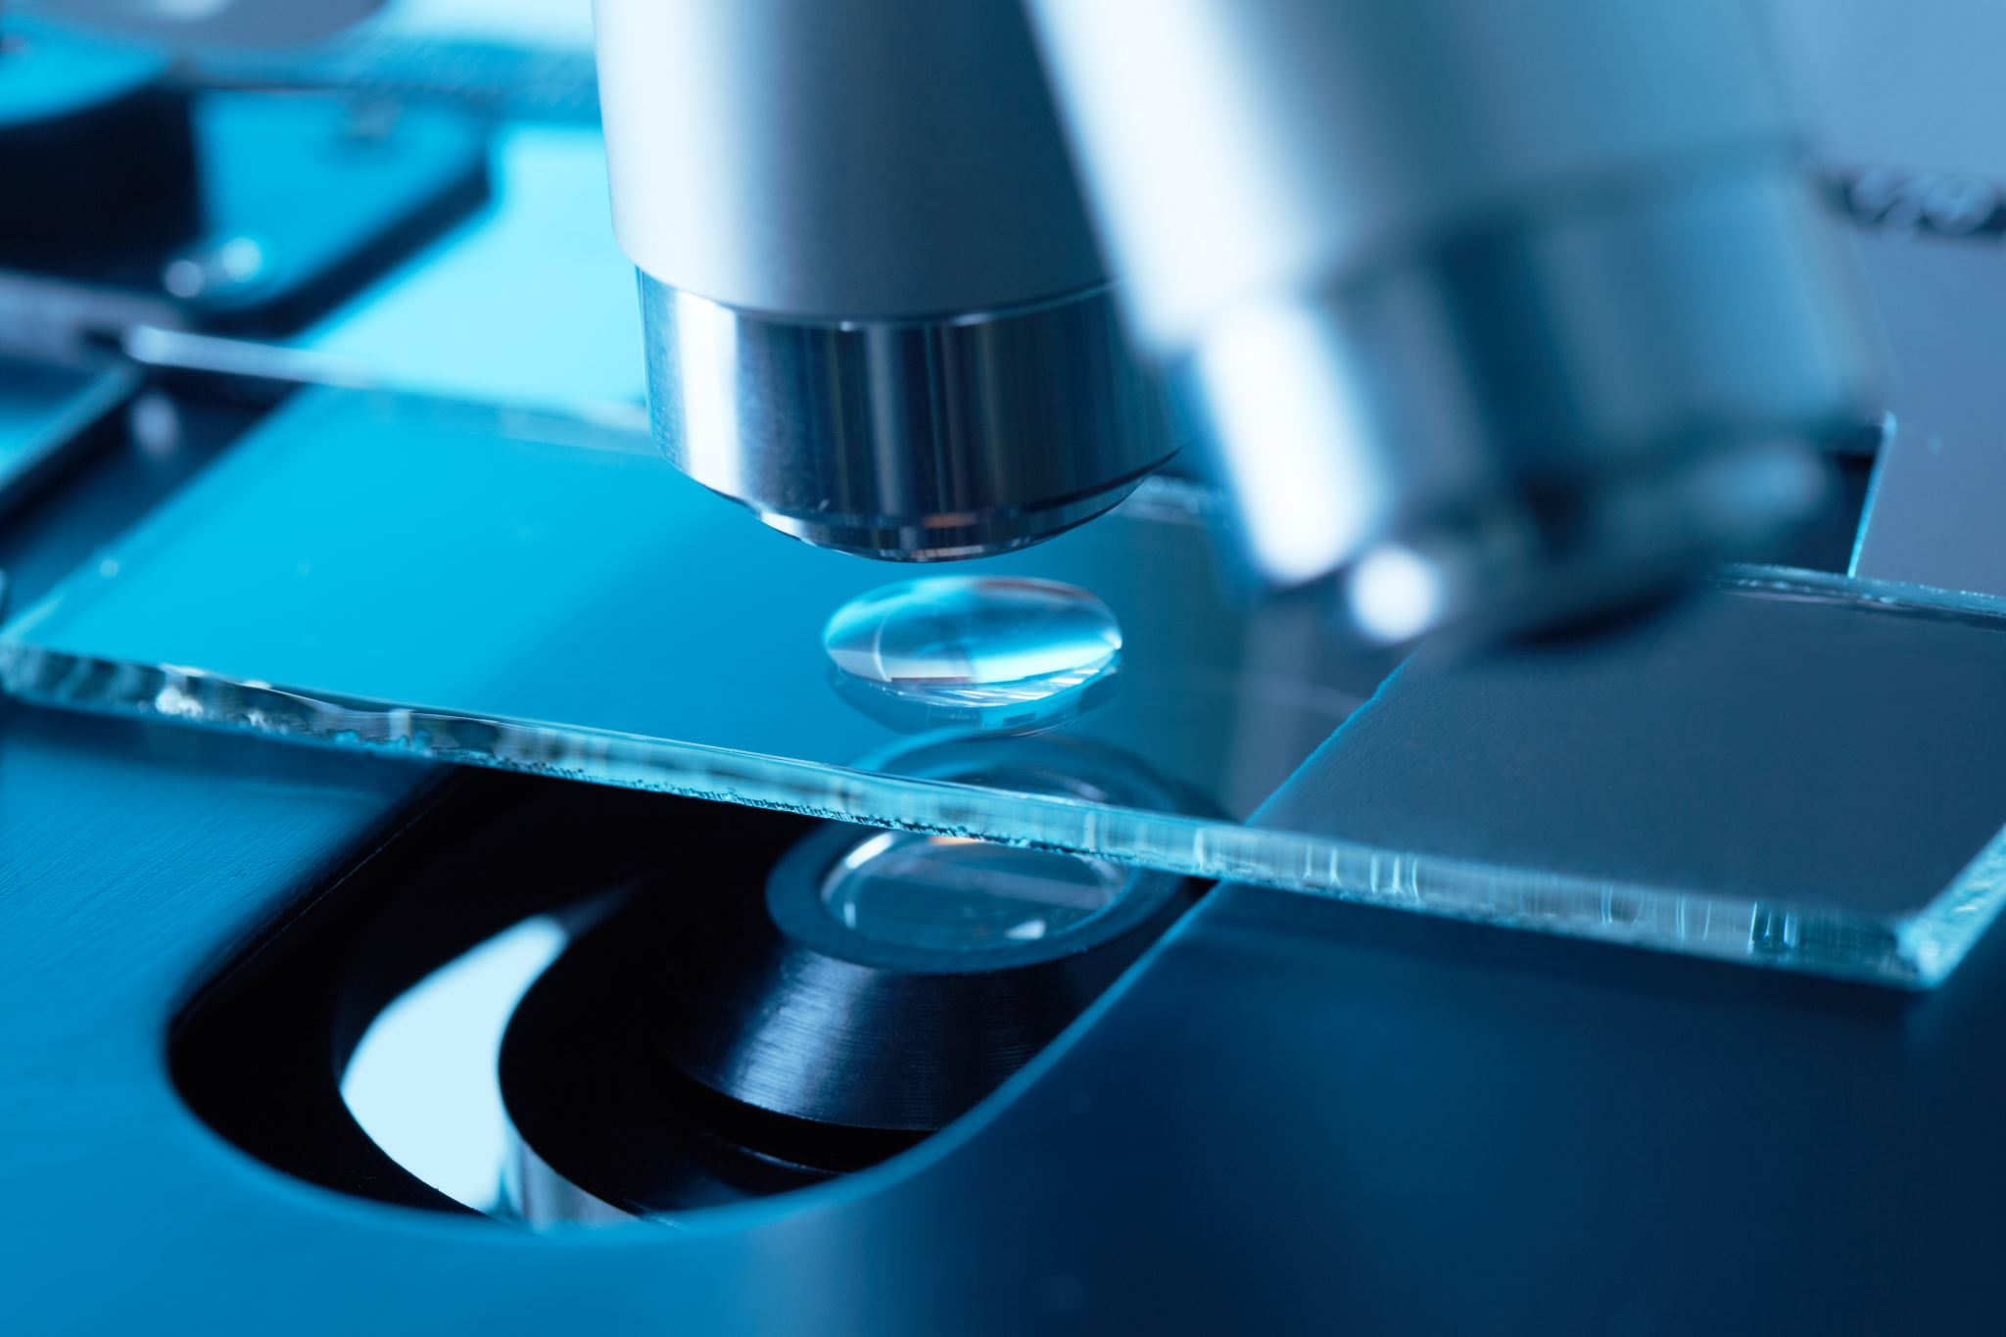
Carolina Biological Supply
Johnston County Professional Development
August 17, 2023

Slide 2
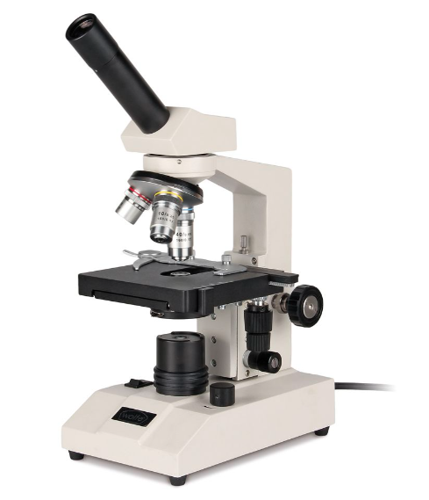
Wolfe HS Series Microscope – 590945
Use and Care

Slide 3
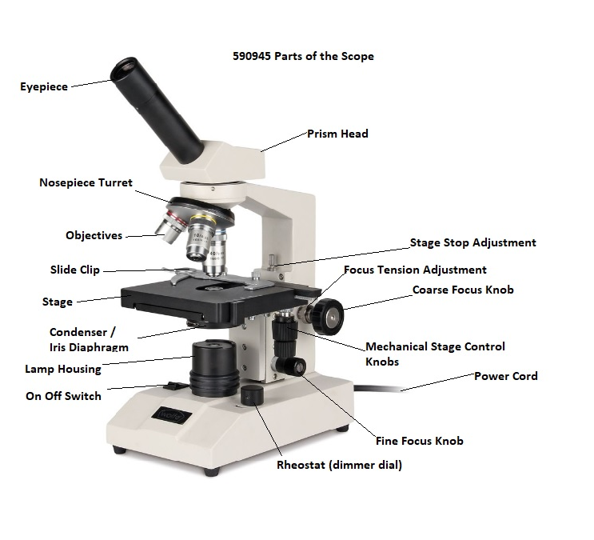
Know your scope

Slide 4
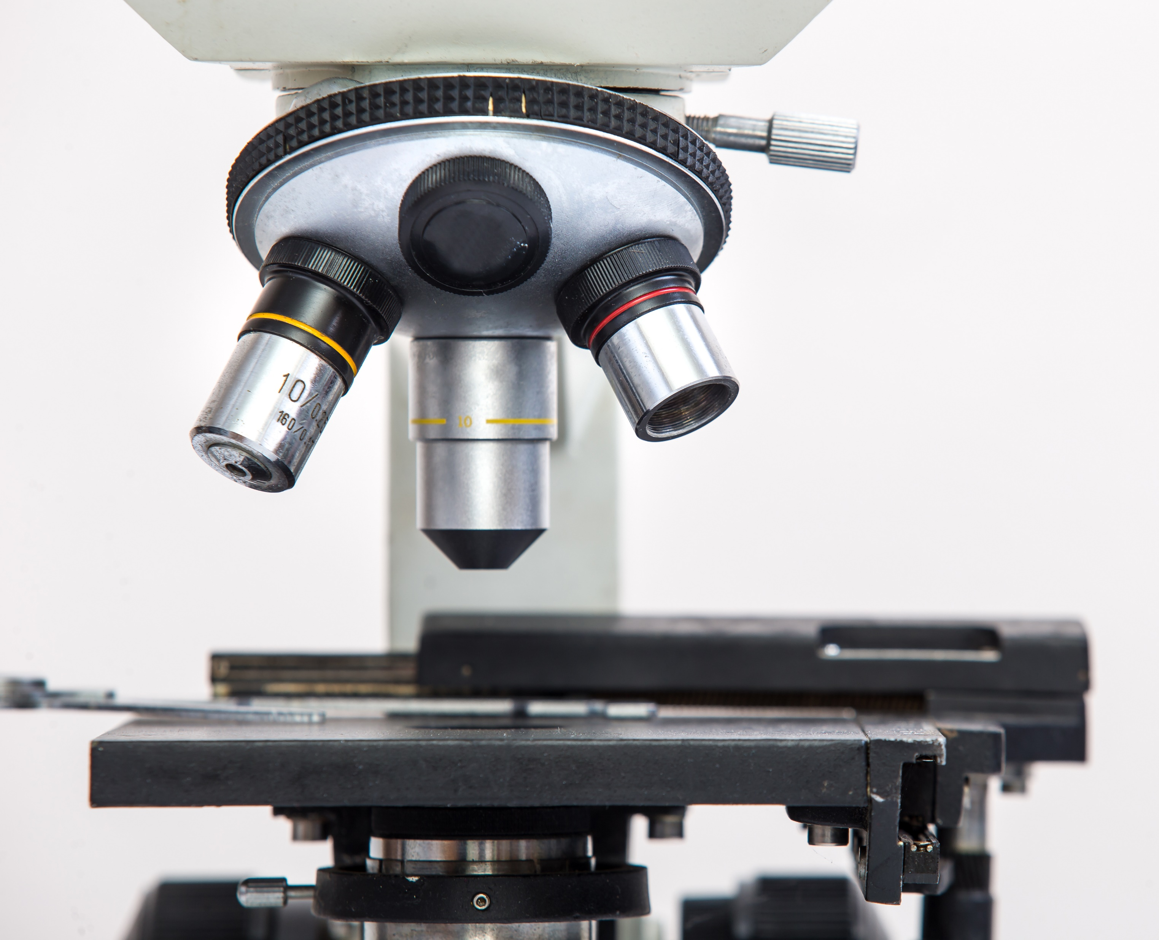
Features and Functions
Rotating Monocular Head
10 x eyepiece with pointer
Three Objective Lenses
Mechanical Stage
LED illumination with dimmer
Coarse and Fine Focus control
Iris Diaphragm

Slide 5
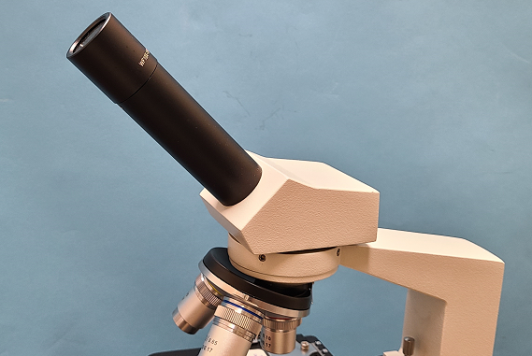
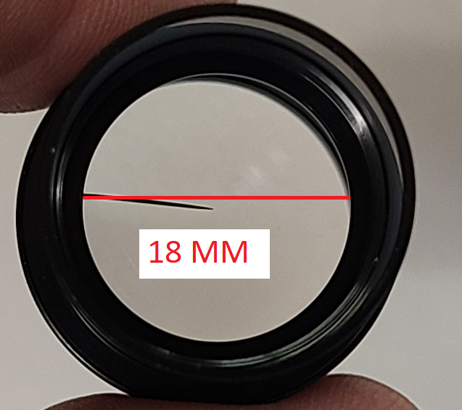
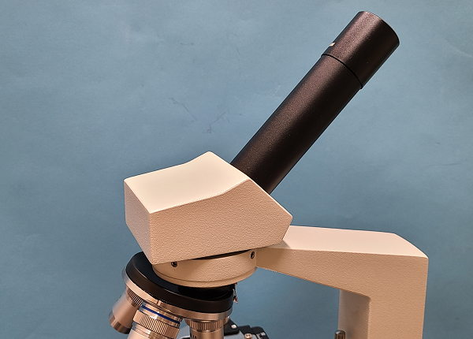

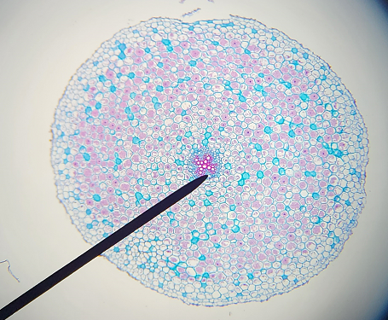

Rotating Monocular Head
10 x eyepiece with pointer
WF = Wide Field
10 X (Magnification amount)
18 MM This is the aperture of the eyepiece ( amount of light coming out of the eyepiece)

Slide 6
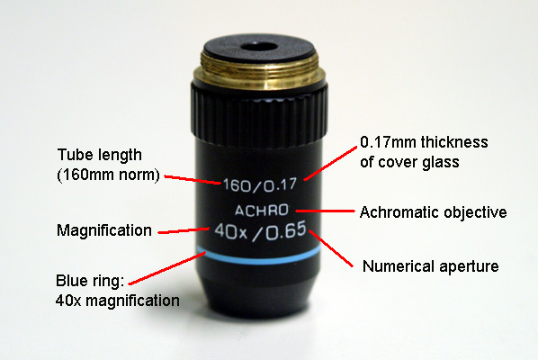
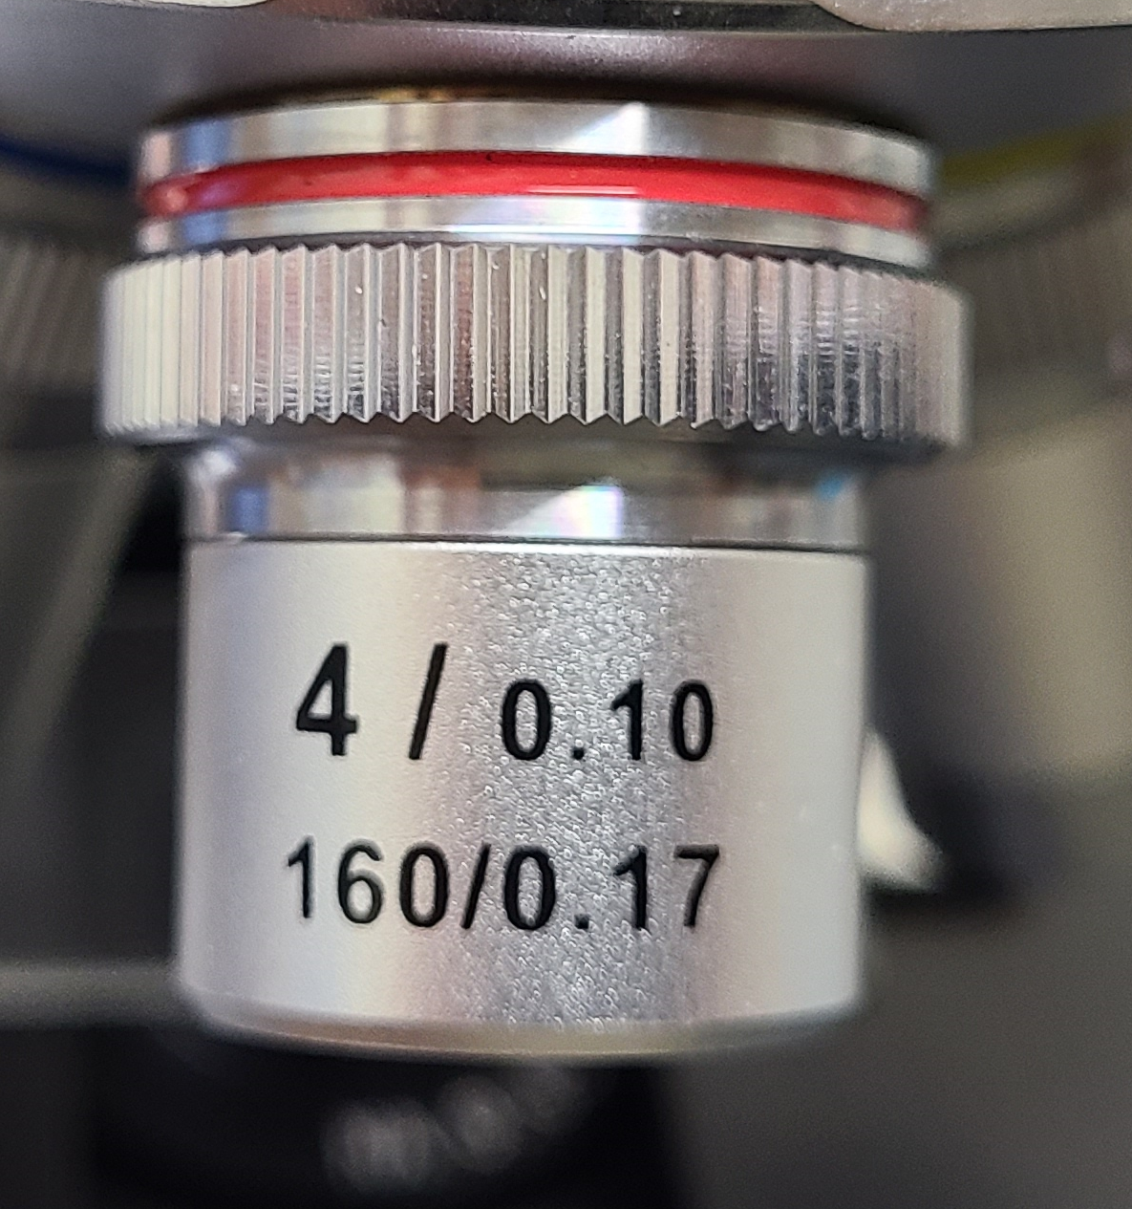
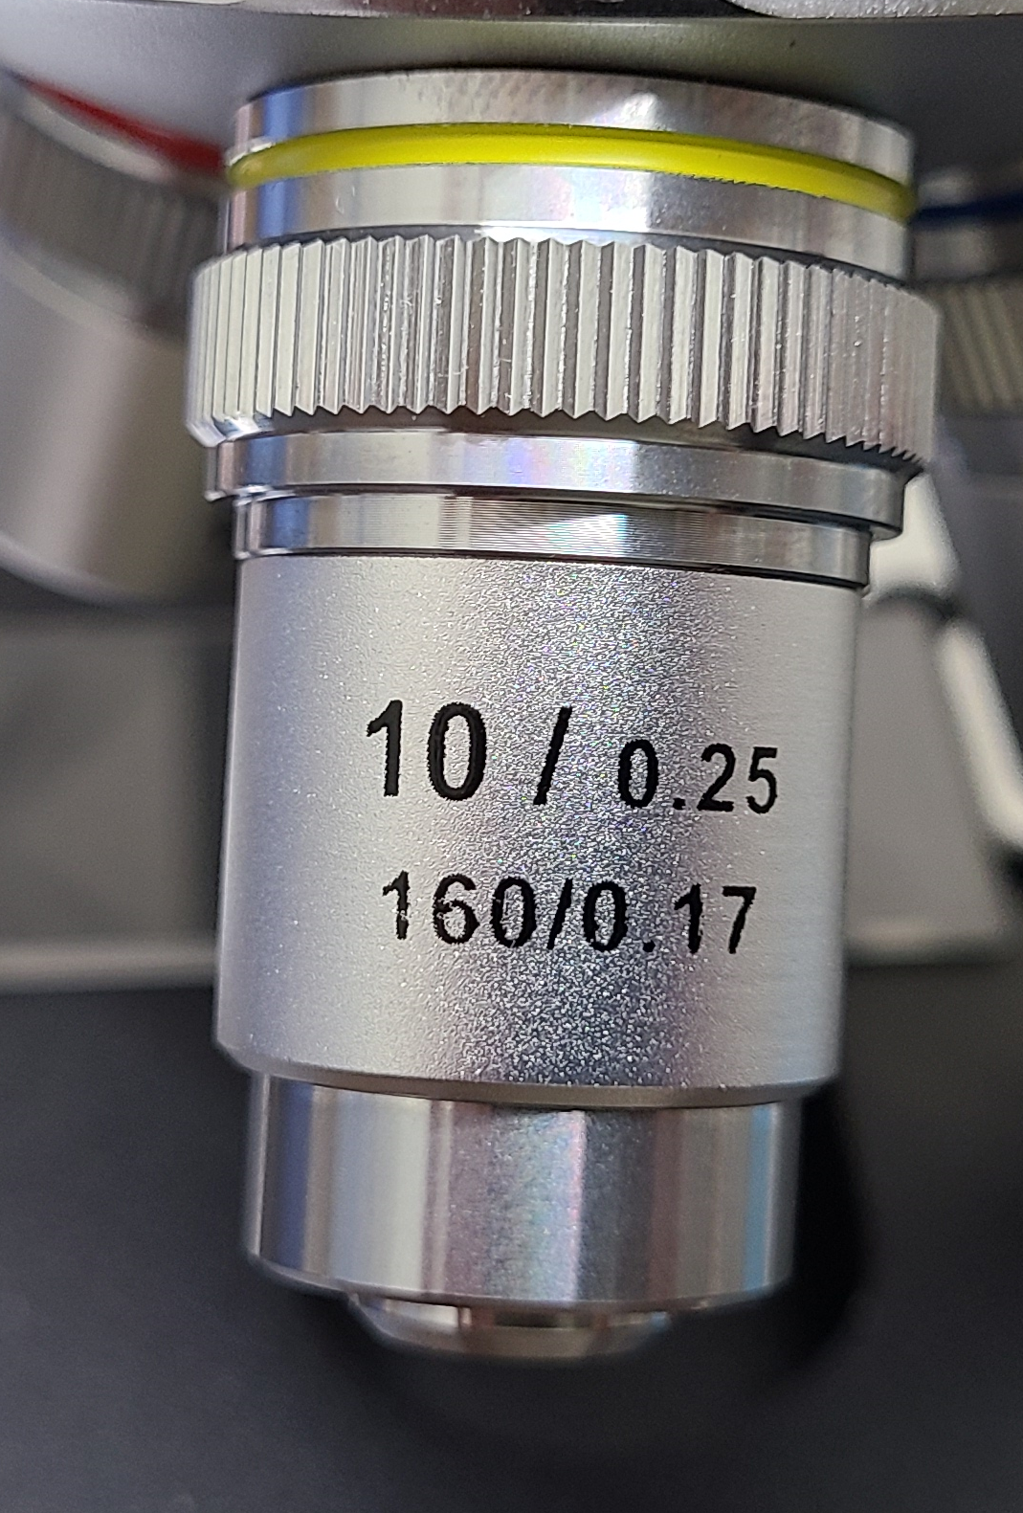
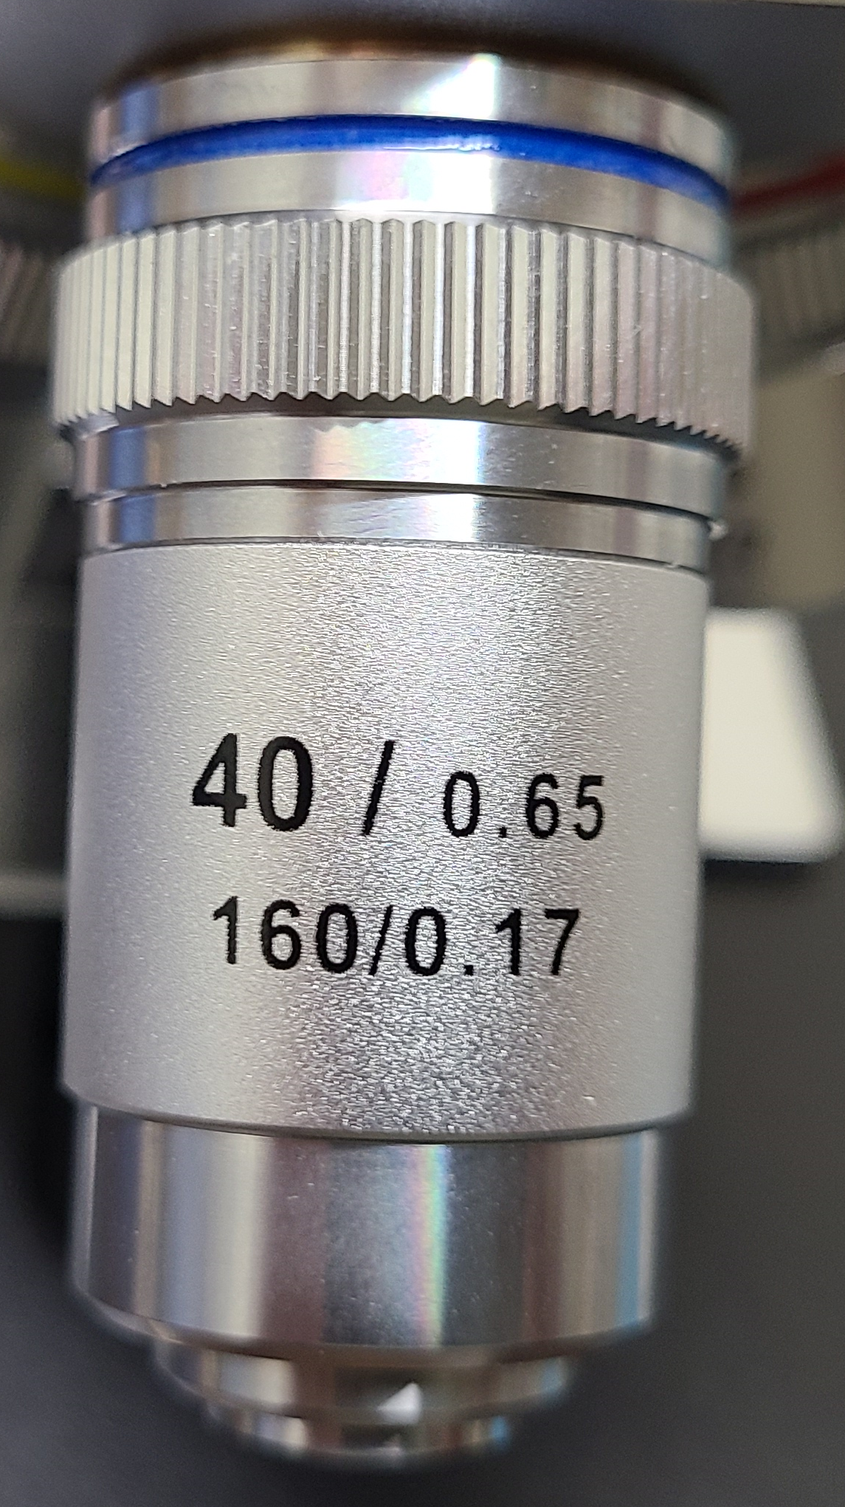
Defining the Objective Numbers

Slide 7
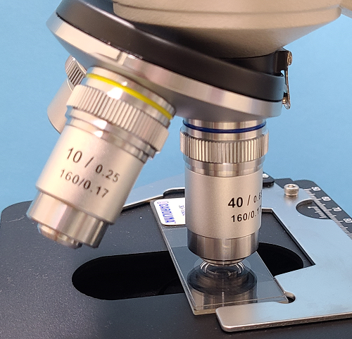
Total Magnification = eyepiece lens mag. X objective lens mag.
Examples: 10X eyepiece with a 4X Objective = 40X magnification.
10X Objective gives you 100X magnification
40X Objective gives 400X viewing.
These three magnifications are the most standard usable powers in microscopy.
X

Slide 8
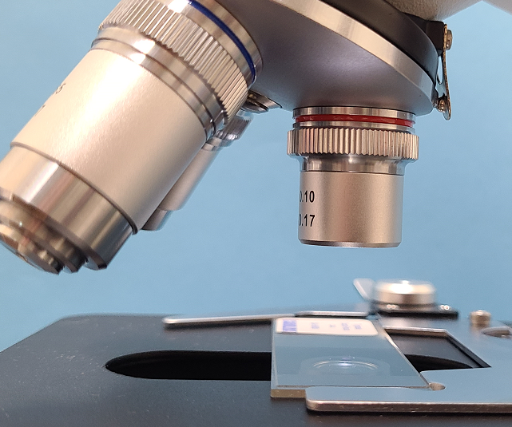
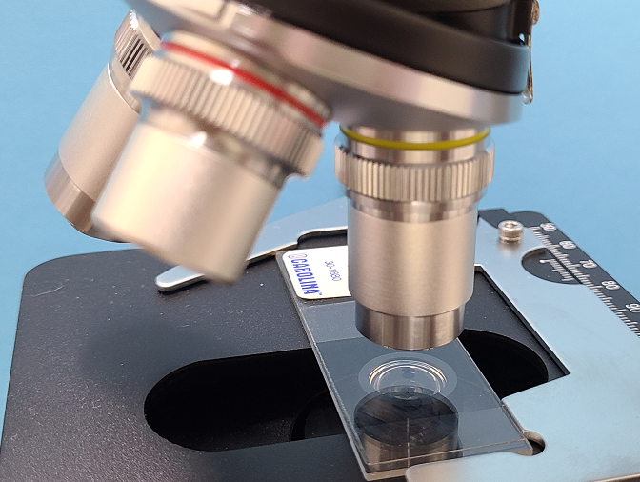
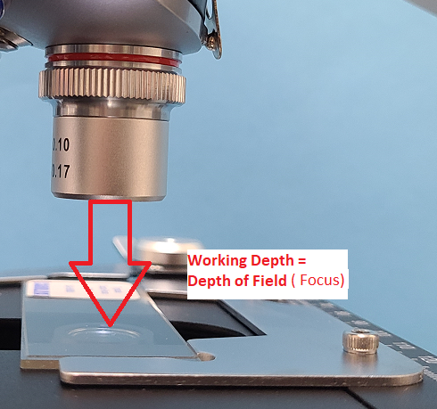
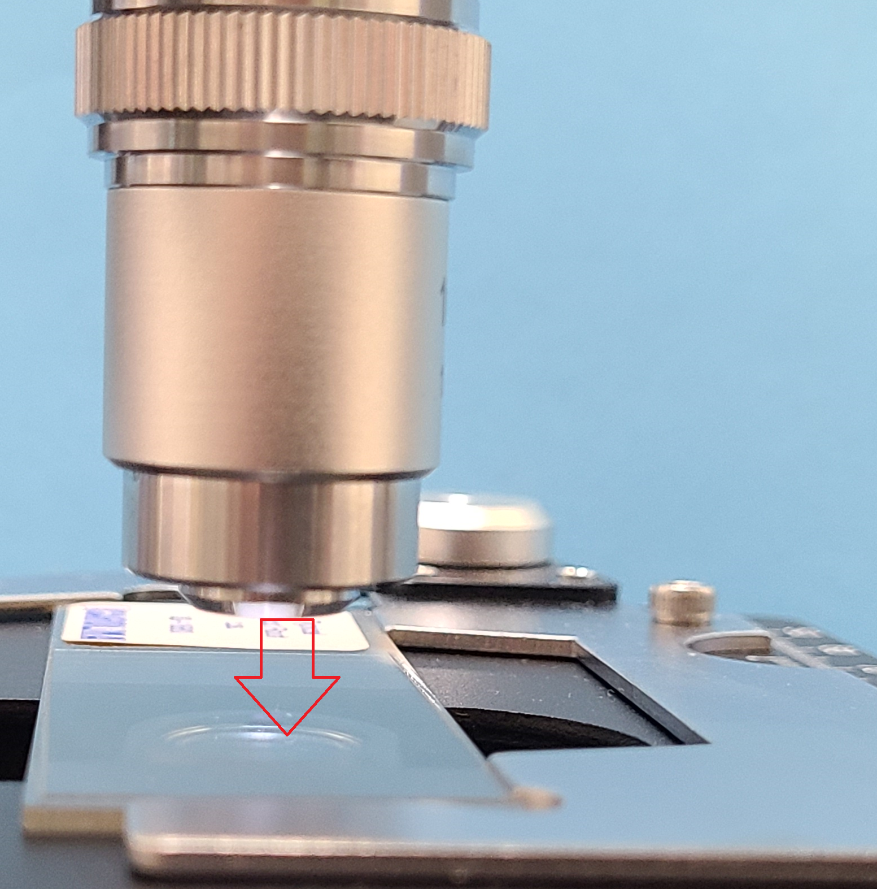
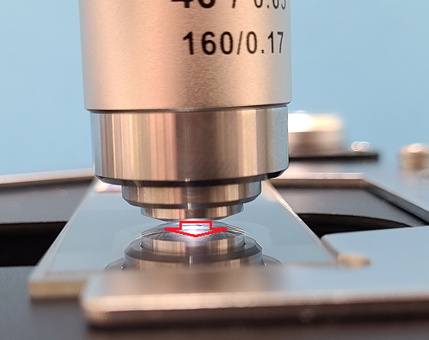
Three Objective Lenses
4 X 10 X 40 X
40 magnification 100 magnification 400 magnification

Slide 9
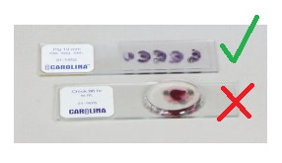
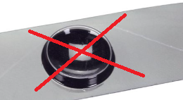

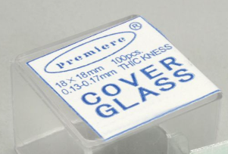
Damage Prevention
The 40X is the most damaged objective from use of overly thick slides and using wet mounts with out a cover slip.
There is a very narrow margin of space
between the 40 X objective and the slide.
To prevent damage to the Objective and Slide, never use an overly thick slide when using the 40X.

Slide 10
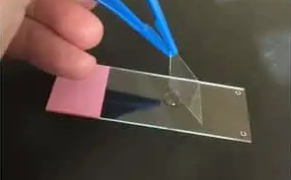
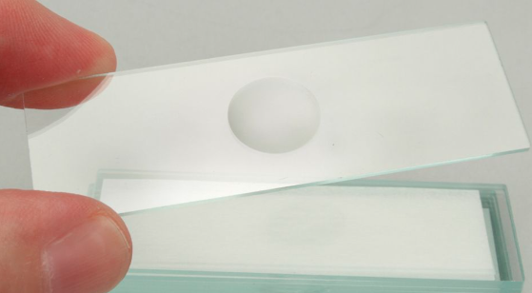
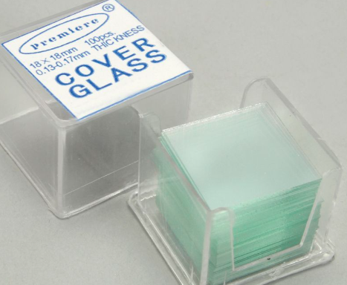
Prevent Damage from Liquids
Always use a cover slip on a wet mount slide to help prevent liquid damaging the objectives.

Slide 11
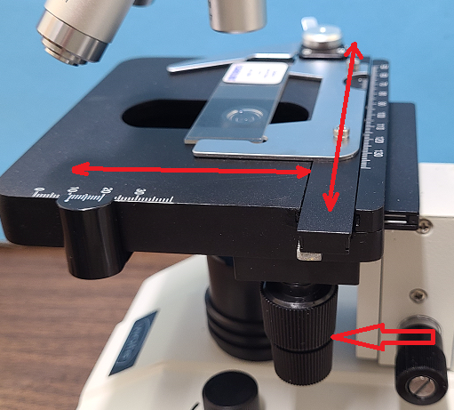
Mechanical Stage
The mechanical stage:
allows you to move the slide for centering,
locate areas within the specimen without touching it.
The vertical knobs allow side to side and back and forward movement.

Slide 12
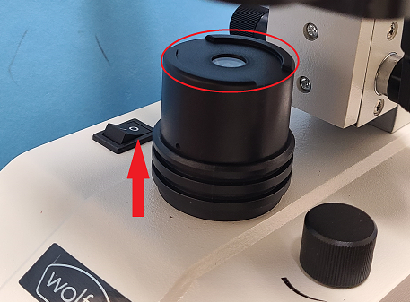
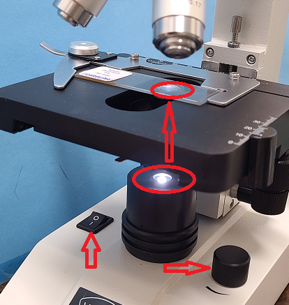
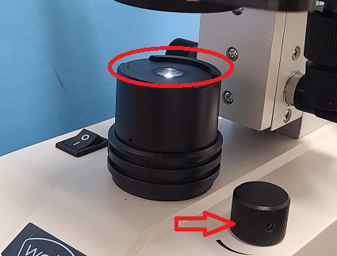
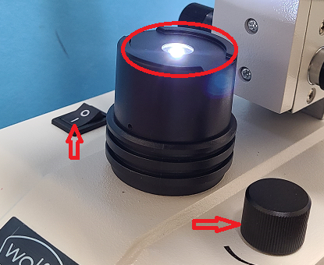
LED Illumination with Dimmer
The light is activated by the on/off switch.
To increase or decrease the amount of light, rotate the rheostat (dimmer dial) to the amount of light needed.

Slide 13
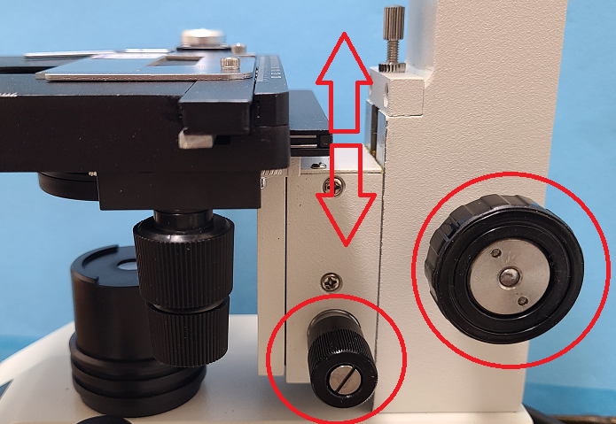
Coarse and Fine Focus Control
With the coarse focus knob (larger knob) move the stage up or down to allow basic focus on the slide.
To refine the image, use the fine focus (small knob) to critically sharpen the image.

Slide 14
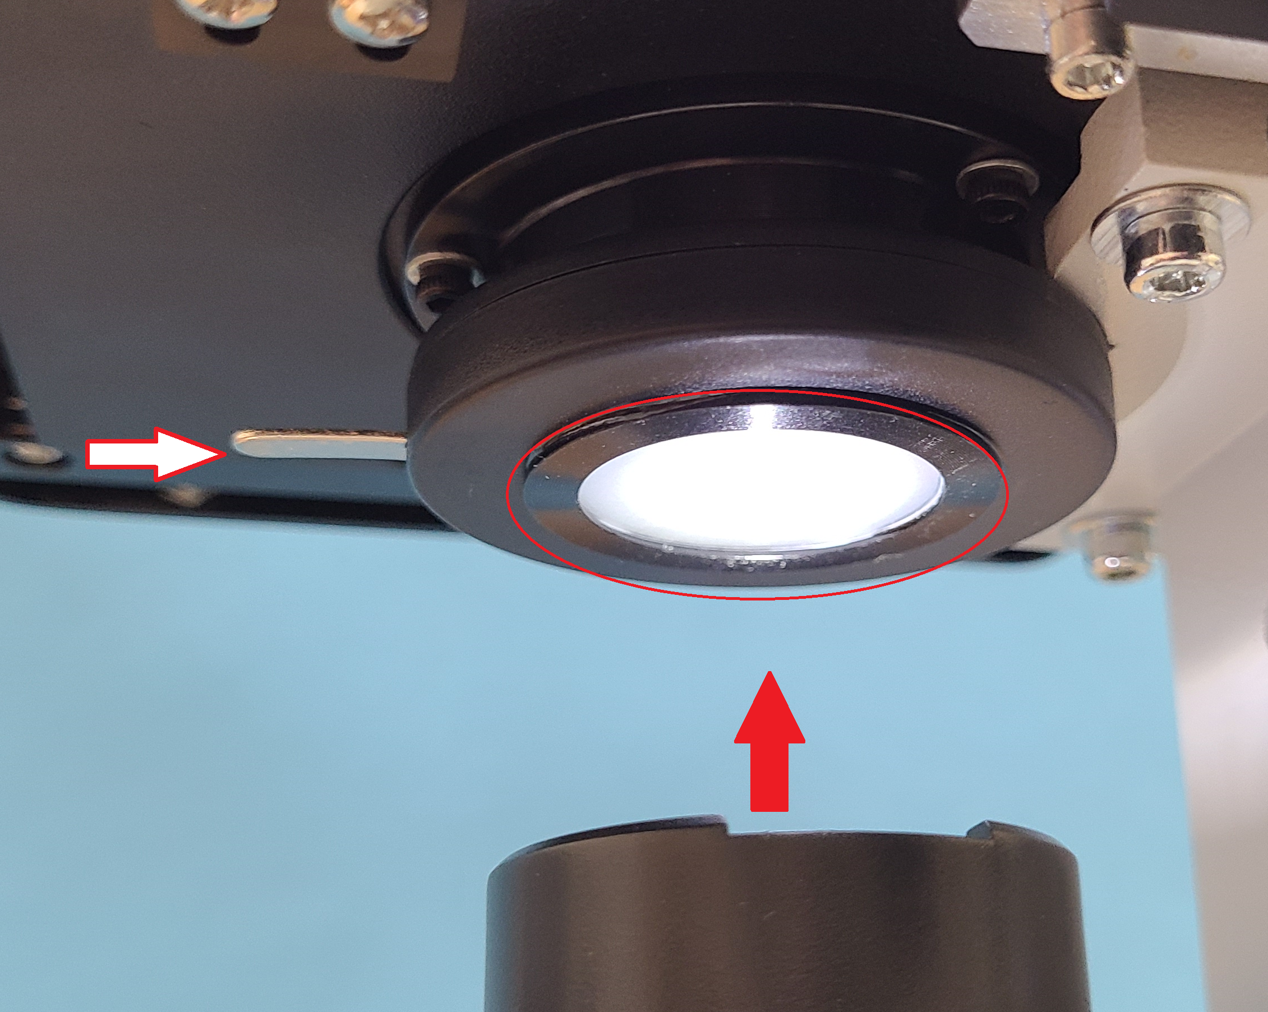
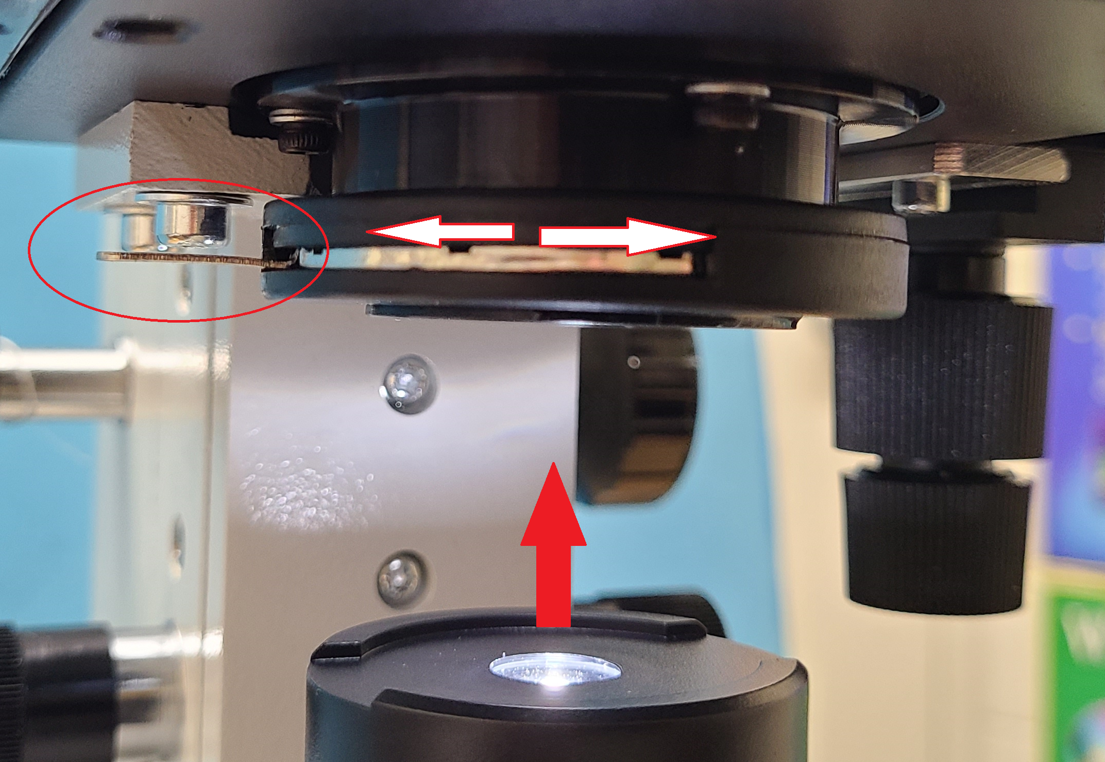
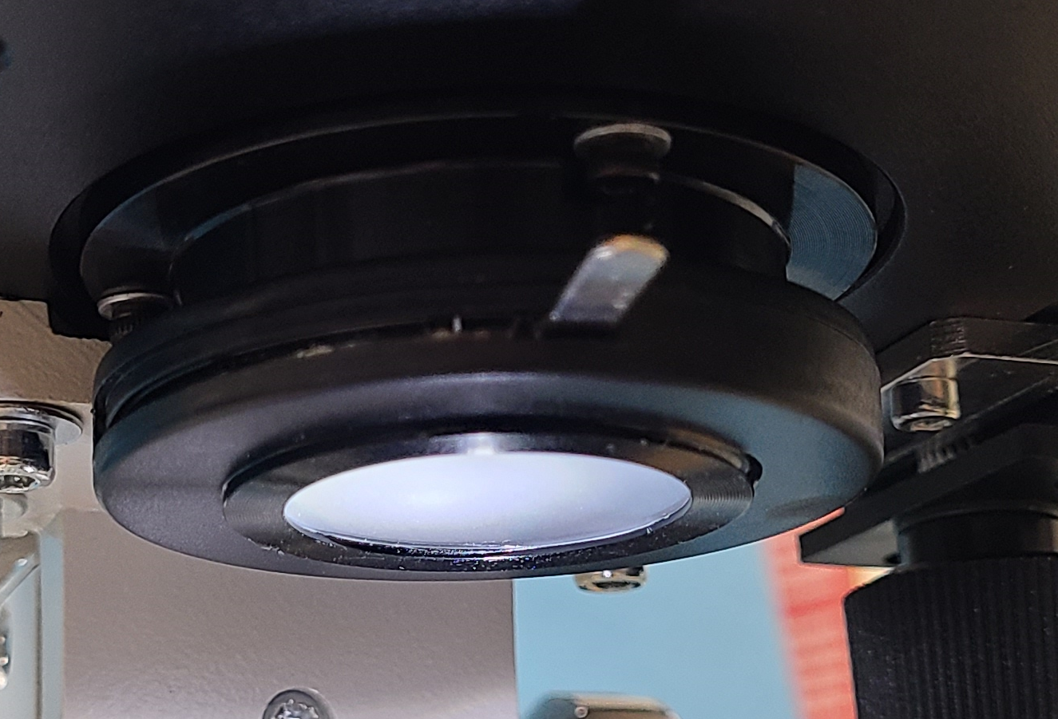
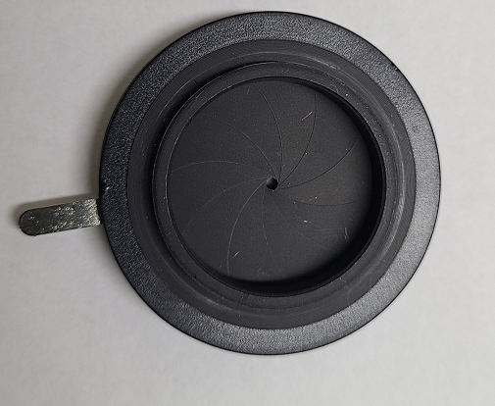
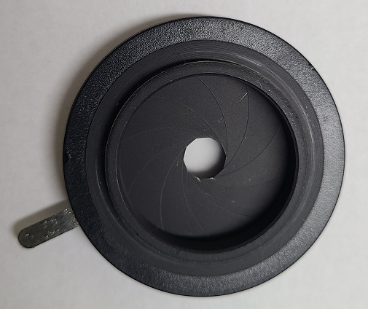
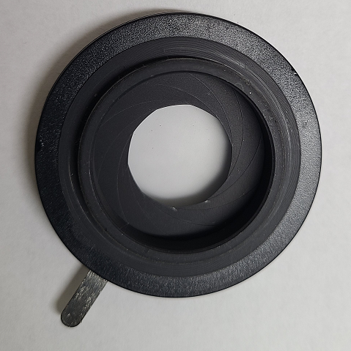
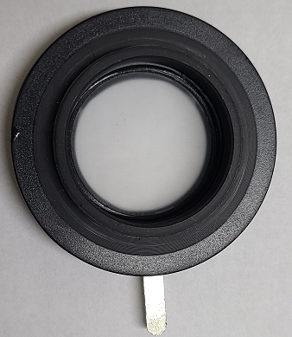
Iris Diaphragm
The iris diaphragm is used to regulate the amount of light from the lamp housing into the condenser and up through the slide.

Slide 15
Iris Diaphragm
The iris is opened and closed to allow different amounts of light on the slide.
Closing-down the iris restricts the light and is used with thin specimen slides or when you want to see depth in the slide.
Opening-up the iris will help with a specimen that isn’t as transparent however it will also give less depth in the image.

Slide 16
Operation of the Scope
Plug the scope into the wall outlet. A surge protection outlet strip is recommended.
Place the scope on a sturdy flat surface.
Place a slide onto the mechanical stage and center slide.
Rotate the nose piece turret (objective lens ) to the 4X.
Start with the coarse focus, (large knob) as needed to refine the image.
To modify the light, use the dimmer and iris diaphragm to adjust the light to improve the quality of image.

Slide 17
Operation of the Scope, cont.
The 4X will show the widest view of your slide.
Move the slide around using the mechanical stage knobs.
Once you have viewed your area of interest with the 4X, magnify the image by rotating the nose piece to the 10X objective.
It is likely the image will be slightly out of focus. To refine the image, use the fine focus knob.
If needed, you can adjust the lighting with the dimmer or iris diaphragm.

Slide 18
Things to Remember
As you move up in magnification, you will need to adjust focus and lighting.
The stronger the magnification, more light is needed. This will vary with the thickness or thinness of your slide. You can rotate to the 40X for maximum magnification.
When using higher magnifications remember there is much less light coming into the objective than with the 4X and 10X.

Slide 19
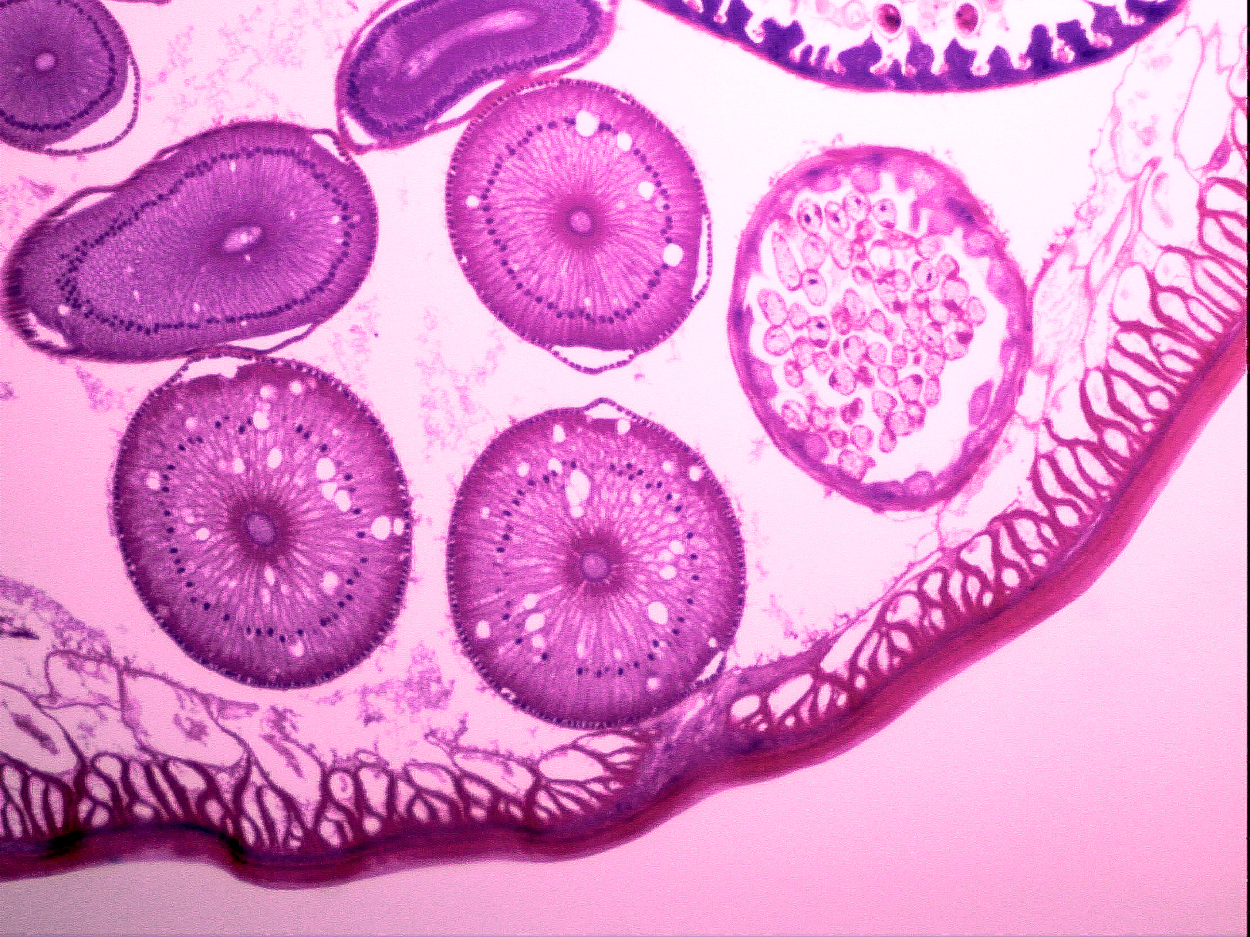
Things to Remember, cont.
With higher magnification, you will experience much less depth within the specimen slide.
With experience you will be able to manage the quality of viewing with the iris diaphragm and light dimmer combination.

Slide 20
Summary
Basic microscopy:
Placement of Slide - objective - center slide – adjust light
Focus
Movement of slide with mechanical stage
Magnification: always start with the 4X to scan the slide for area of wanted detail
There is a very narrow margin of space between the
40 X objective and the slide
6. To prevent damage to the objective and slide, never use an overly thick slide when using the 40X

Slide 21
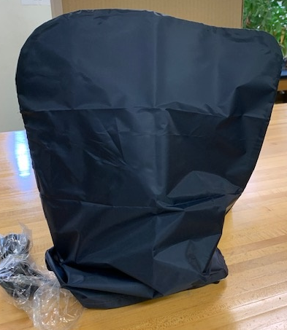
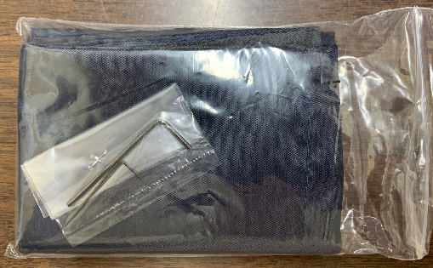
Maintenance and Care of the Microscope
Packaged with your scope you will have:
Dust cover
Allen wrenches. Keep the Allen wrenches for future needs.
Always keep the dust cover on the scope when not in use.

Slide 22
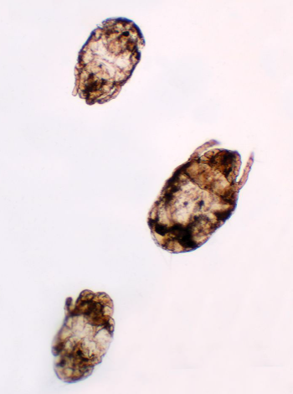
Remember
Dust and debris is the number one issue resulting in poor quality microscope viewing. Dust covers will help.
Occasional cleaning of the scope body and optics will help keep high quality viewing.
Dust can never be eliminated. New scopes will have some dust already in them.
Liquids and oils are also big contributors to damage and poor viewing.
Dust Mites: Dermatophagoides.
Whole Mount microscope slide.
Item# 307558

Slide 23

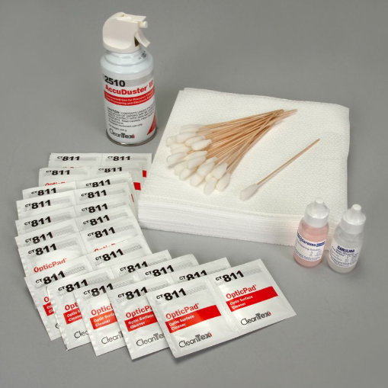
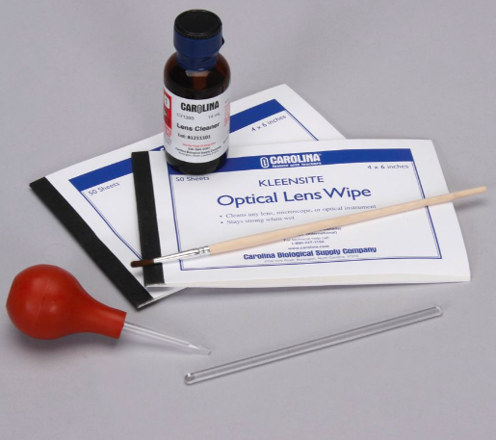
There are many products on the market that will help you keep your microscopes clean and dust free.
Dust Brushes, Cans of Air, Lens Tissue, and Cleaners
Item # 633950 Item # 633970 Item # 591720

Slide 24
The eyepiece and objectives and condenser glass will be the most noticeable areas where dust and debris will be visible.
It is good practice to clean the eyepieces after each session to prevent fingerprints and smudges from remaining on these glass surfaces.
A simple cleaning with a tiny drop of optical lens cleaner on a lens tissue is all that is needed.
Then cover with the dust cover for storage.

Slide 25
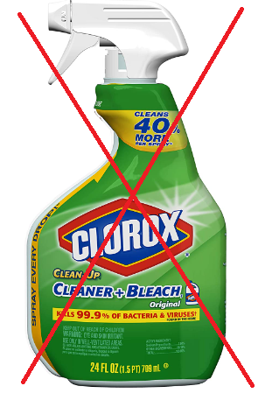
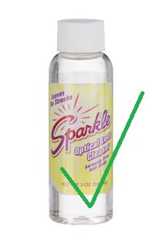
Another good practice is to occasionally clean your slides of fingerprints and dust. Anything on the slide surface will be seen in the scope’s eyepiece.
Optics are not sealed against water and liquids.
Never use any liquid that is not for optical use on the eyepieces, objectives, and condenser.

Slide 26
Cleaning the outside areas of the scope can be done with basic paper towels and nonabrasive cleaners with alcohol.
There are many harsh, abrasive cleaners on the market that can damage the finish of the scope and the coatings on the optics. Never use them!
When cleaning the eyepiece and objectives, remove the dust first. Once the dry dust has been removed, you can clean the optics.
Always use a tiny drop of cleaner on the lens tissue and never directly on the eyepiece or objective.

Slide 27
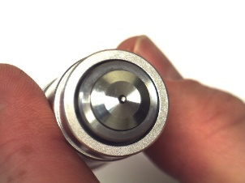
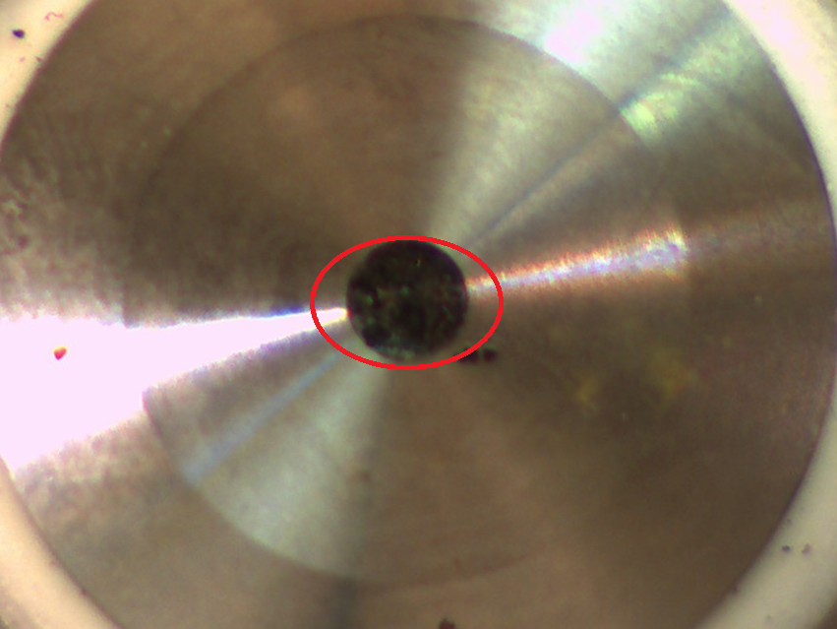
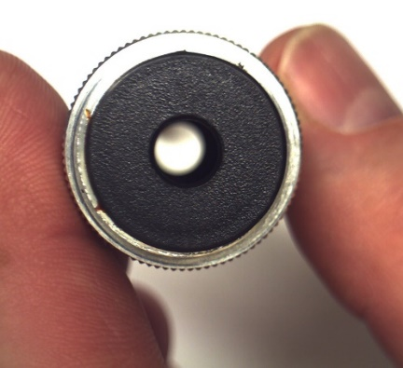
When the scope has been subjected to liquid specimens, you may need to remove the objective lens and view through it to see what is blocking the light and preventing a quality image.

Slide 28
Safety First-Chemicals and PPE
At the beginning of every school year check for the following:
Adequate numbers of PPE- goggles, safety glasses, gloves, aprons, etc.
Updated school/district chemical hygiene plan.
Updated SDS lists or printed copies in every lab room, chemical storage room, and even the fire station that services the school.
SDS Sections 2,4,6,7, and 8 spell out hazards, PPE, first aid, and clean-up. Be familiar with information and share with students.
Know your district/school hazardous chemical disposal procedures.

Slide 29
Safety First- Equipment
At the beginning of every school year check for the following:
Broken, chipped, or cracked glassware.
Frayed electrical cords.
Safety equipment is in working order and is easily accessible. (eyewash, fume hood or exhaust fan, fire extinguisher, fire blanket, first aid kit, broken glass and hazards containers, chemical spill kits, etc.).
Battery powered equipment has batteries and no signs of corrosion.

Slide 30
Safety First-Students and Parents
At the beginning of every school year check for the following:
Have a general or course specific safety agreement for student and parent signatures.
Organize the room to ensure there is adequate space for movement, equipment dispersal, and access to safety equipment.

Slide 31
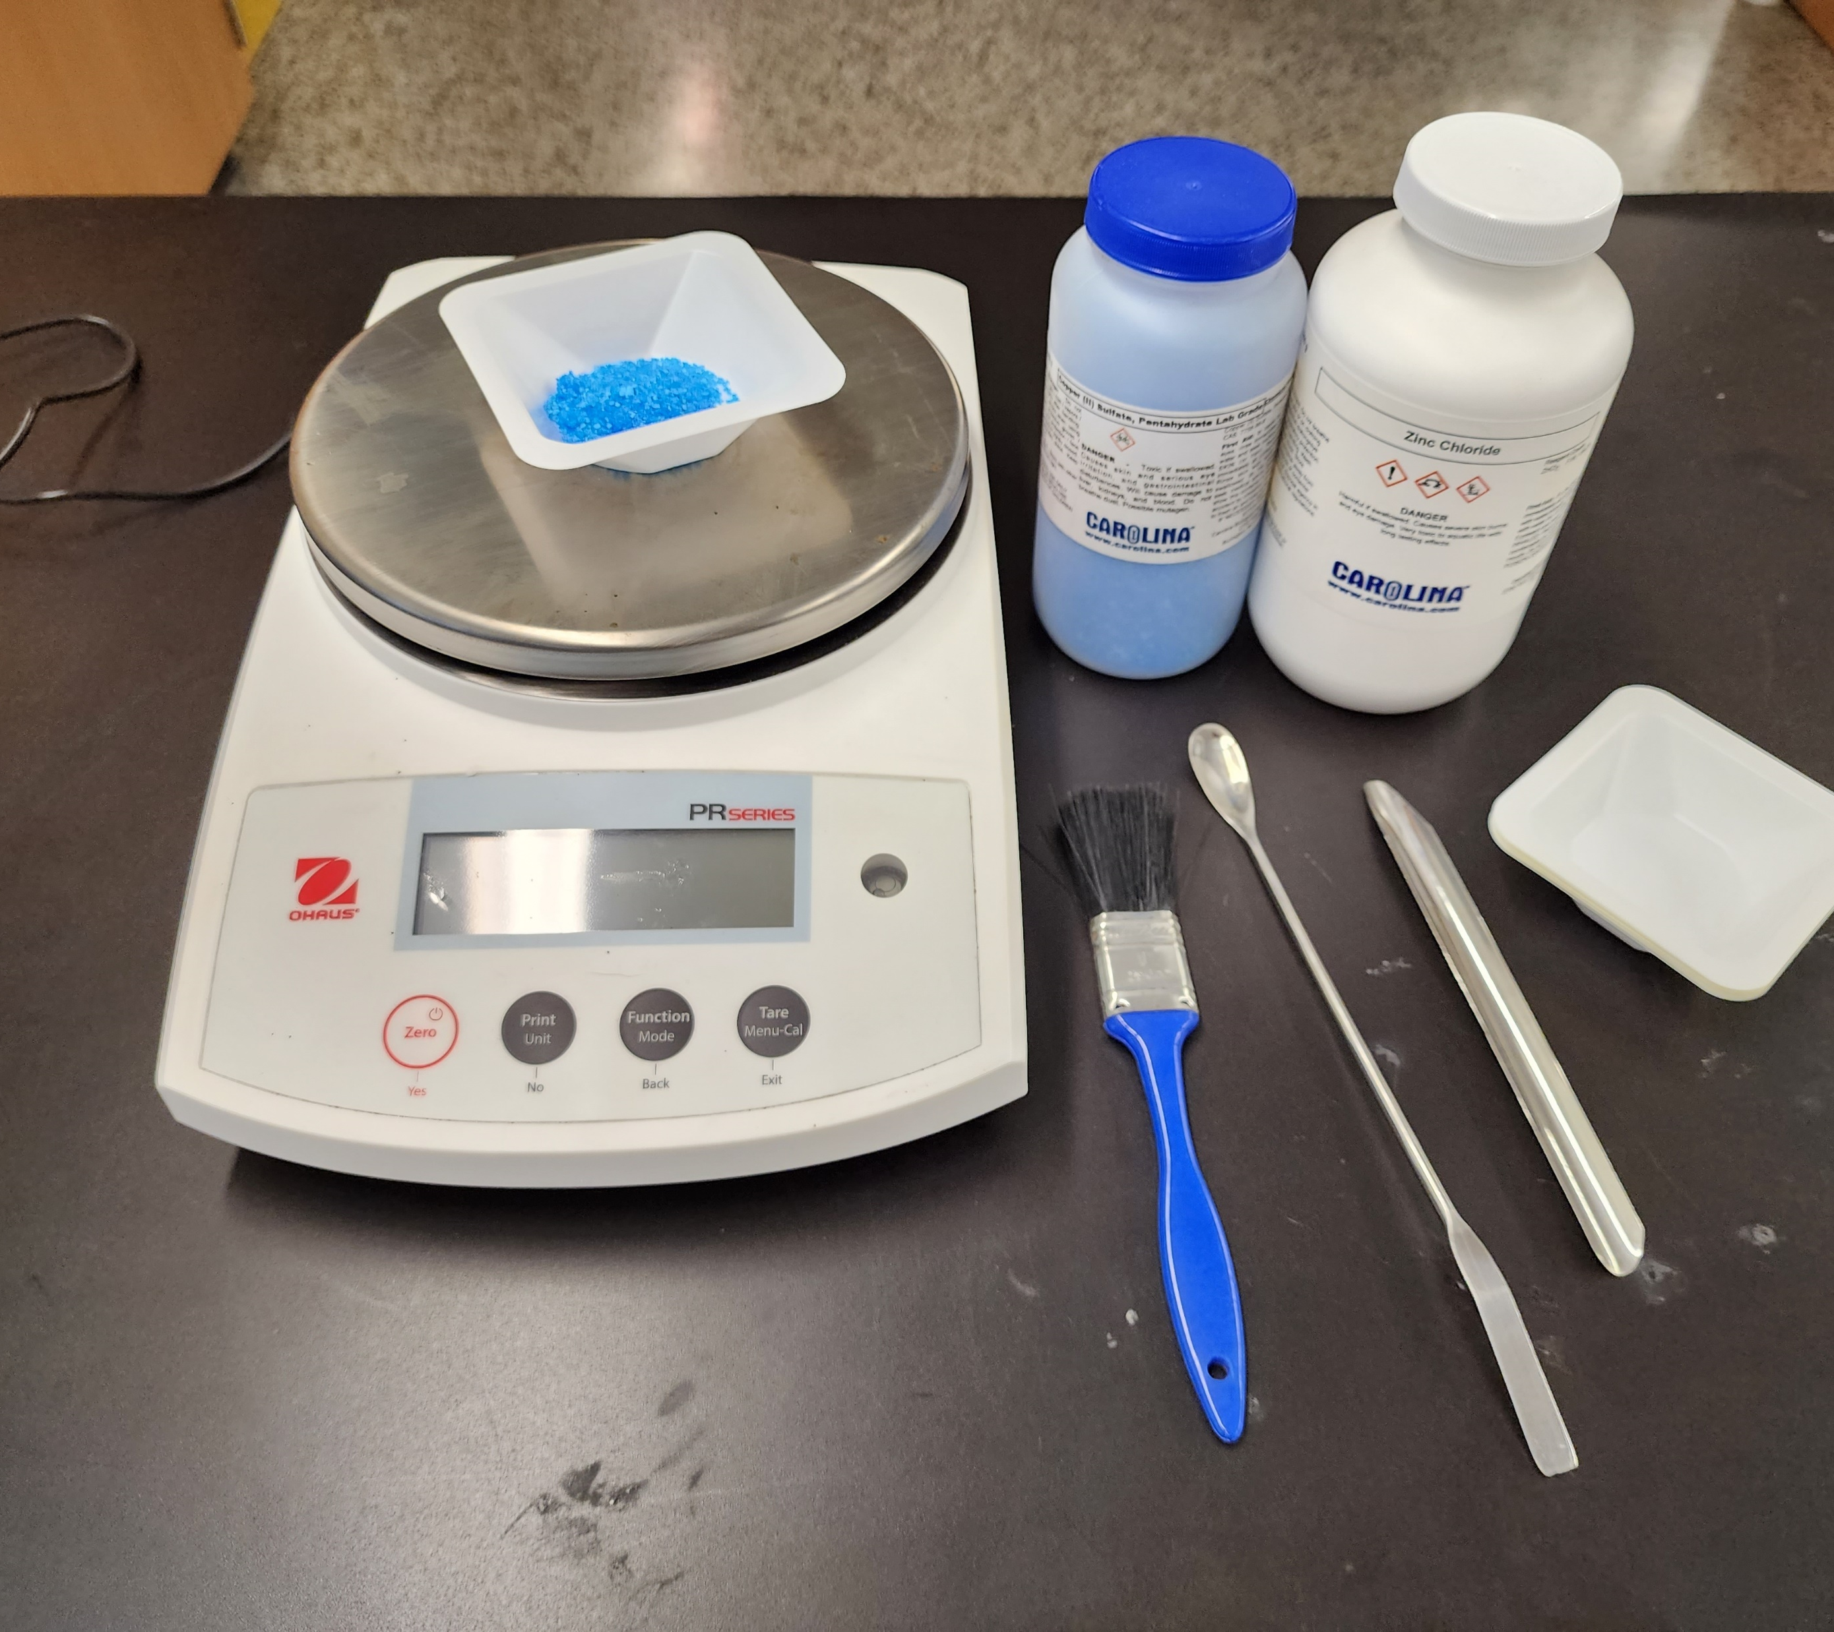
Get to know your equipment:
Microscopes
Glassware and plasticware
Electronic balances

Slide 32
Glassware and Plasticware
What determines the use of glassware/plasticware?
What information is found on glassware and plasticware?
Carefully unwrap the glassware in your table bag.
Examine each one carefully.
What are their uses?

Slide 33
Get to know your equipment:
Microscopes
Glassware and plasticware
Electronic balances

Slide 34
Electronic Balances
Check the power source.
Check the unit of measure. (g or oz.)
Zero the balance.
Center the weigh boat on the balance.
Tare/zero out the mass of the weigh boat.
Add the substance to the weigh boat and record the mass of the object.
Mass all the objects in the activity bag.
Remove the substance and re-zero the balance.

Slide 35
Get to know your equipment:
Microscopes
Glassware and plasticware
Electronic balances

Slide 36
Carolina wishes to THANK the teachers, administrators, and County Office staff for choosing us to meet your planning needs and your students’ instructional needs. We are excited and pleased to be your instructional partner.
For any questions, contact us at: product@carolina.com

Slide 37
Helpful free content links
General Information
General Products and online catalog
Articles and free activities
Science safety
Lab safety agreements - English and Spanish
Organizing your space for safe, efficient and engaging lab activities
Buying guides
Returning to school safely
Closing up the lab
Microscopy Content
Get to know your microscope
Microscope buying guide
How to handle, store, and repair microscope slides
How to make microscope slides for science fair projects
Squash an onion and learn the true age of your cells
Glassware and Glassware Safety
Ultimate lab basics buying guide
Glassware and plasticware specifications
How to clean laboratory glassware
Infographic: Laboratory Glassware Basics
How to use a graduated cylinder
Solution preparation guide
Graduated cylinder practice
Accuracy of glassware
Infographic: How to Measure the Volume of Liquids
Balances
Balances buying guide
Electronic balance features video
For Assistance: email product@carolina.com

